Slide 1
Nurture Community
Milestone 1

Slide 2
Sypnosis
Purpose is to help needy/hungry people with surplus food from restaurant.
Reduce food wastage in restaurants
Mobile-friendly web application “Nurture Community”
Users: Restaurant Representative and Client

Slide 3
Milestone 1
Backend environment setup and environment setup documentation.
Creation and design of Home page
Designing data dictionary
Test data creation and insertion in database for application basic setup
Database Design schema

Slide 4



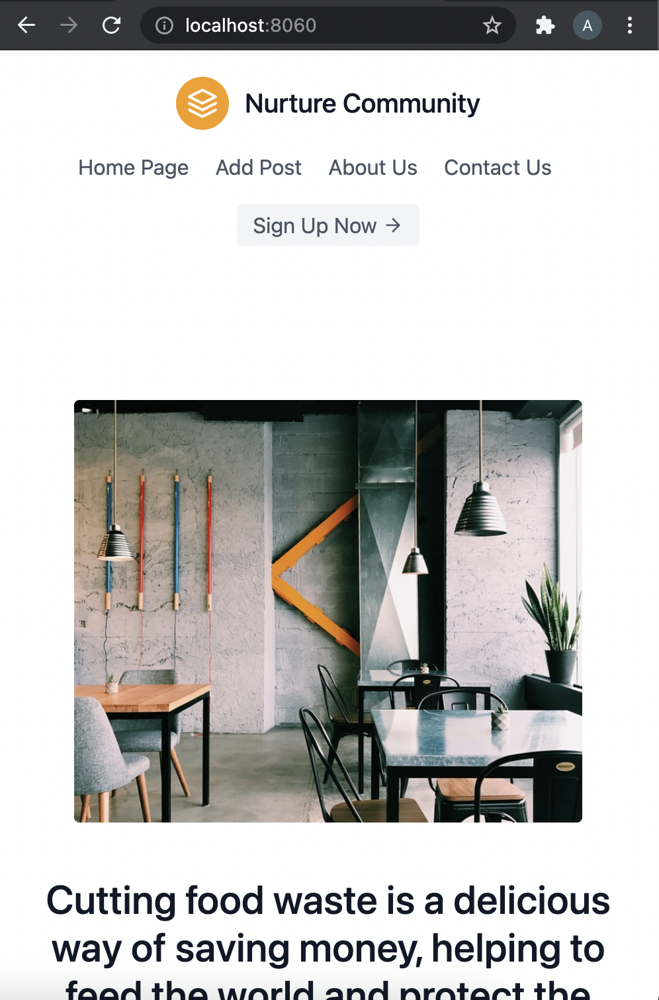
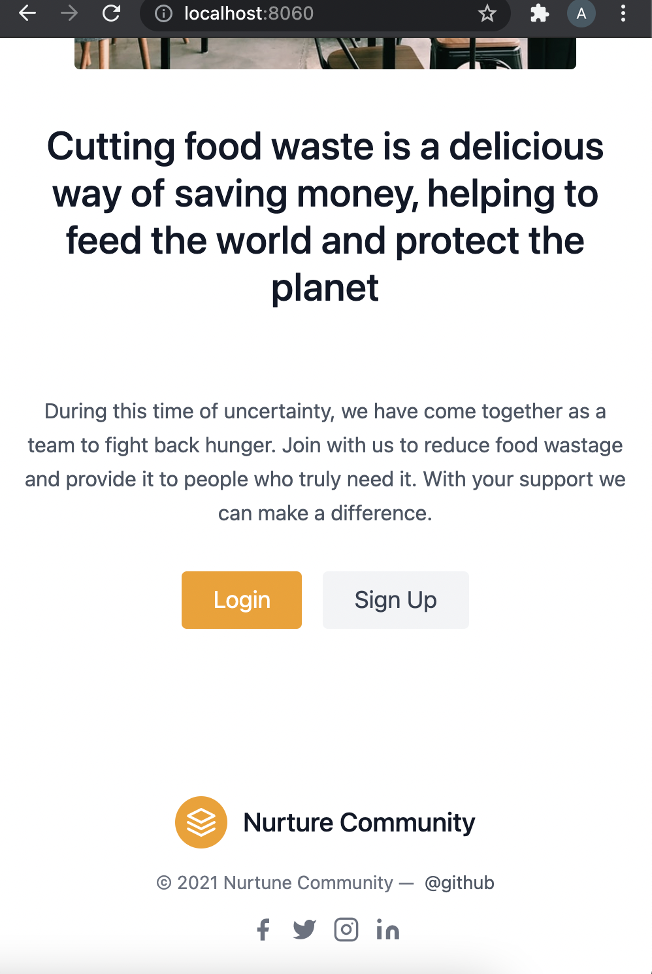
Home page (mobile)
Dynamic images
Heading and description
Sign up button
Login button
Social media links
CSS and HTML implementation
Responsive page

Slide 5
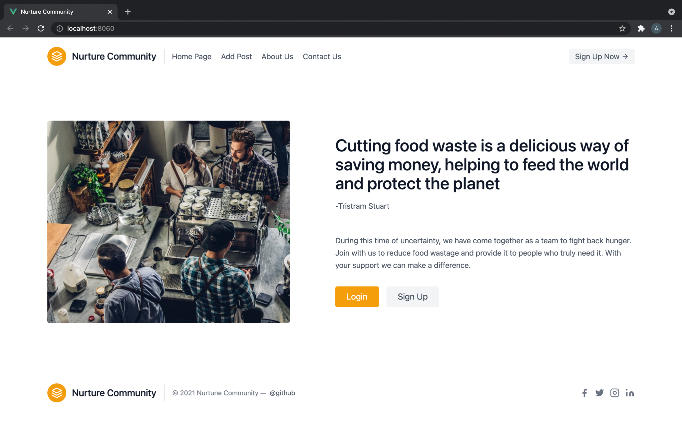
Desktop View

Slide 6
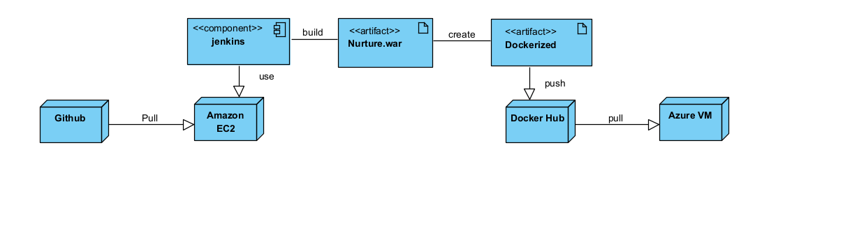
Deployment Plan
Azure for the test environment
AWS for the build server
Jenkins for the orchestration
Ansible for the deployment
Docker for containerization

Slide 7
That’s all for Milestone 1
For the second milestone we will setup up the login and signup page
Send requests back and forth to backend
Backend and front end validation

